Slide 1
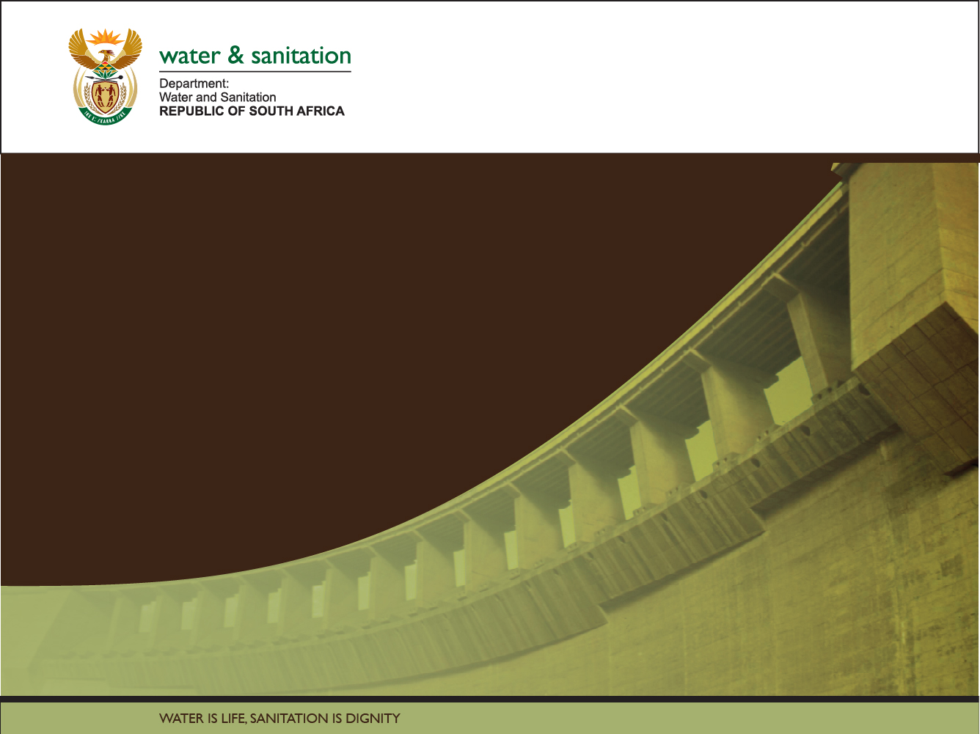

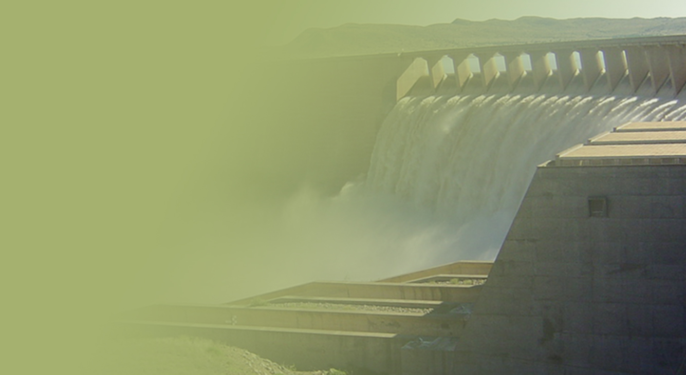
The Determination of Water Resources Classes and Resource Quality Objectives for the water resources in in the Breede-Gouritz WMA
Focus on Breede-Overberg area
Technical Task Group meeting 2: Presentation and workshopping of draft Resource Quality Objectives
Rivers
Presented by: Karl Reinecke
12-16 March 2018
Graham & Rhona Beck Skills Centre, Robertson

Slide 2
Study Objectives
Co-ordinate implementation of the Water Resources Classification System (WRCS):
  Determine Water Resources Classes (WRCs)
  Determine Resource Quality Objectives (RQOs)
  Support Gazetting of Recommended Water Resources Classes and RQOs
  for the water resources in the Breede-Gouritz WMA:
  - Rivers - Estuaries - Groundwater
  - Dams - Wetlands

Slide 3
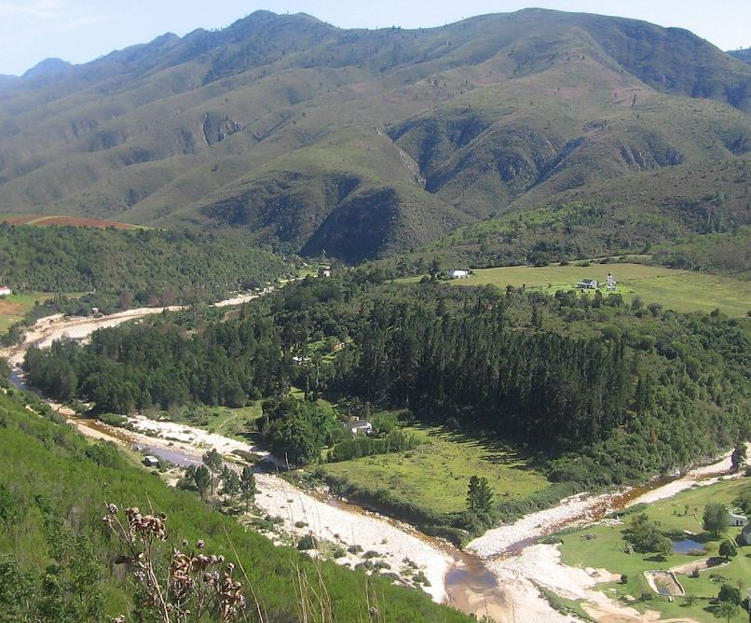

Overview of Study Progress

Slide 4
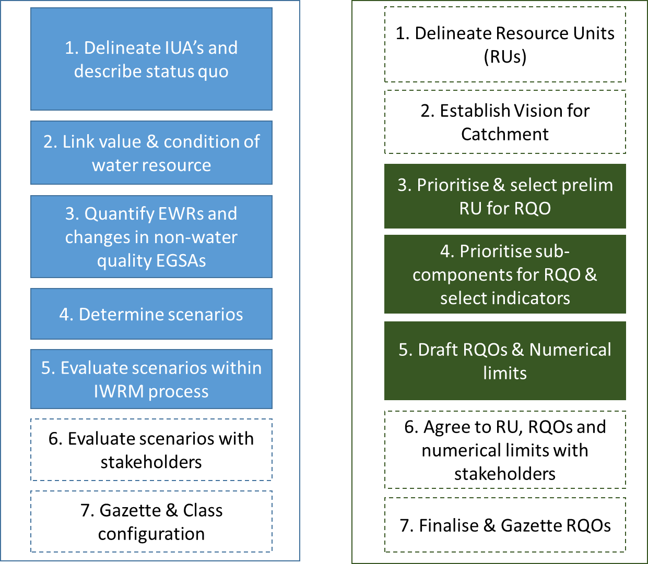

Classification and RQOs Steps
7-step process to determine WRCs
7-step process to determine RQOs
Aligned
Gazette WRC & RQO

Slide 5
Defined Integrated Units of Analysis (IUAs)
  Identified significant resources:
    Based on Physical, Biological & Socio-economic factors
  Each IUA represents a similar area requiring a Water Resources Class (WRC)
  Why do we need these?
    Broad-scale units to assess socio-economic implications of scenarios (possible future situations)
    Report on ecological conditions at a sub-catchment scale
    Set WR Classes for different parts of a catchment
  18 IUAs delineated - 10 in the Breede-Overberg & 8 in the Gouritz-Coastal areas

Slide 6
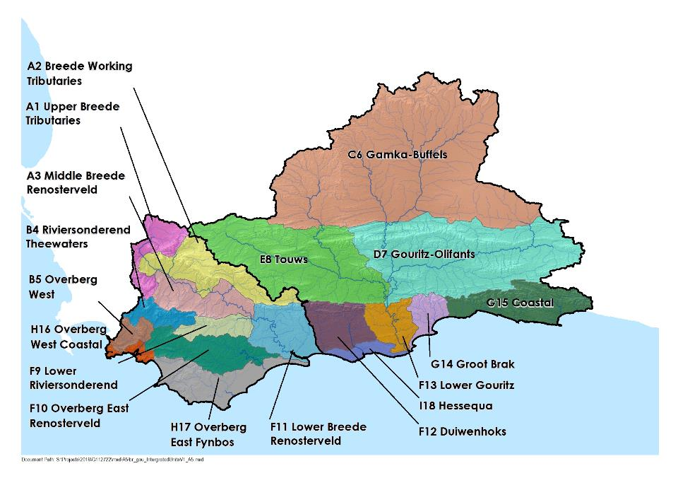
18 Integrated Units of Analysis

Slide 7
Defined Resource Units (RUs) and Nodes
Resource units (RUs) are grouped areas e.g. river basins, deemed similar in terms of various characteristics
Are used to transfer information between catchments
Groundwater
  Nodes are locations of interest (points) in a water resource (rivers, dams, wetlands, estuaries)
  Are sited using:
  Water infrastructure
  Aquatic ecosystem attributes
  Are used to allocate water for environment and development

Slide 8
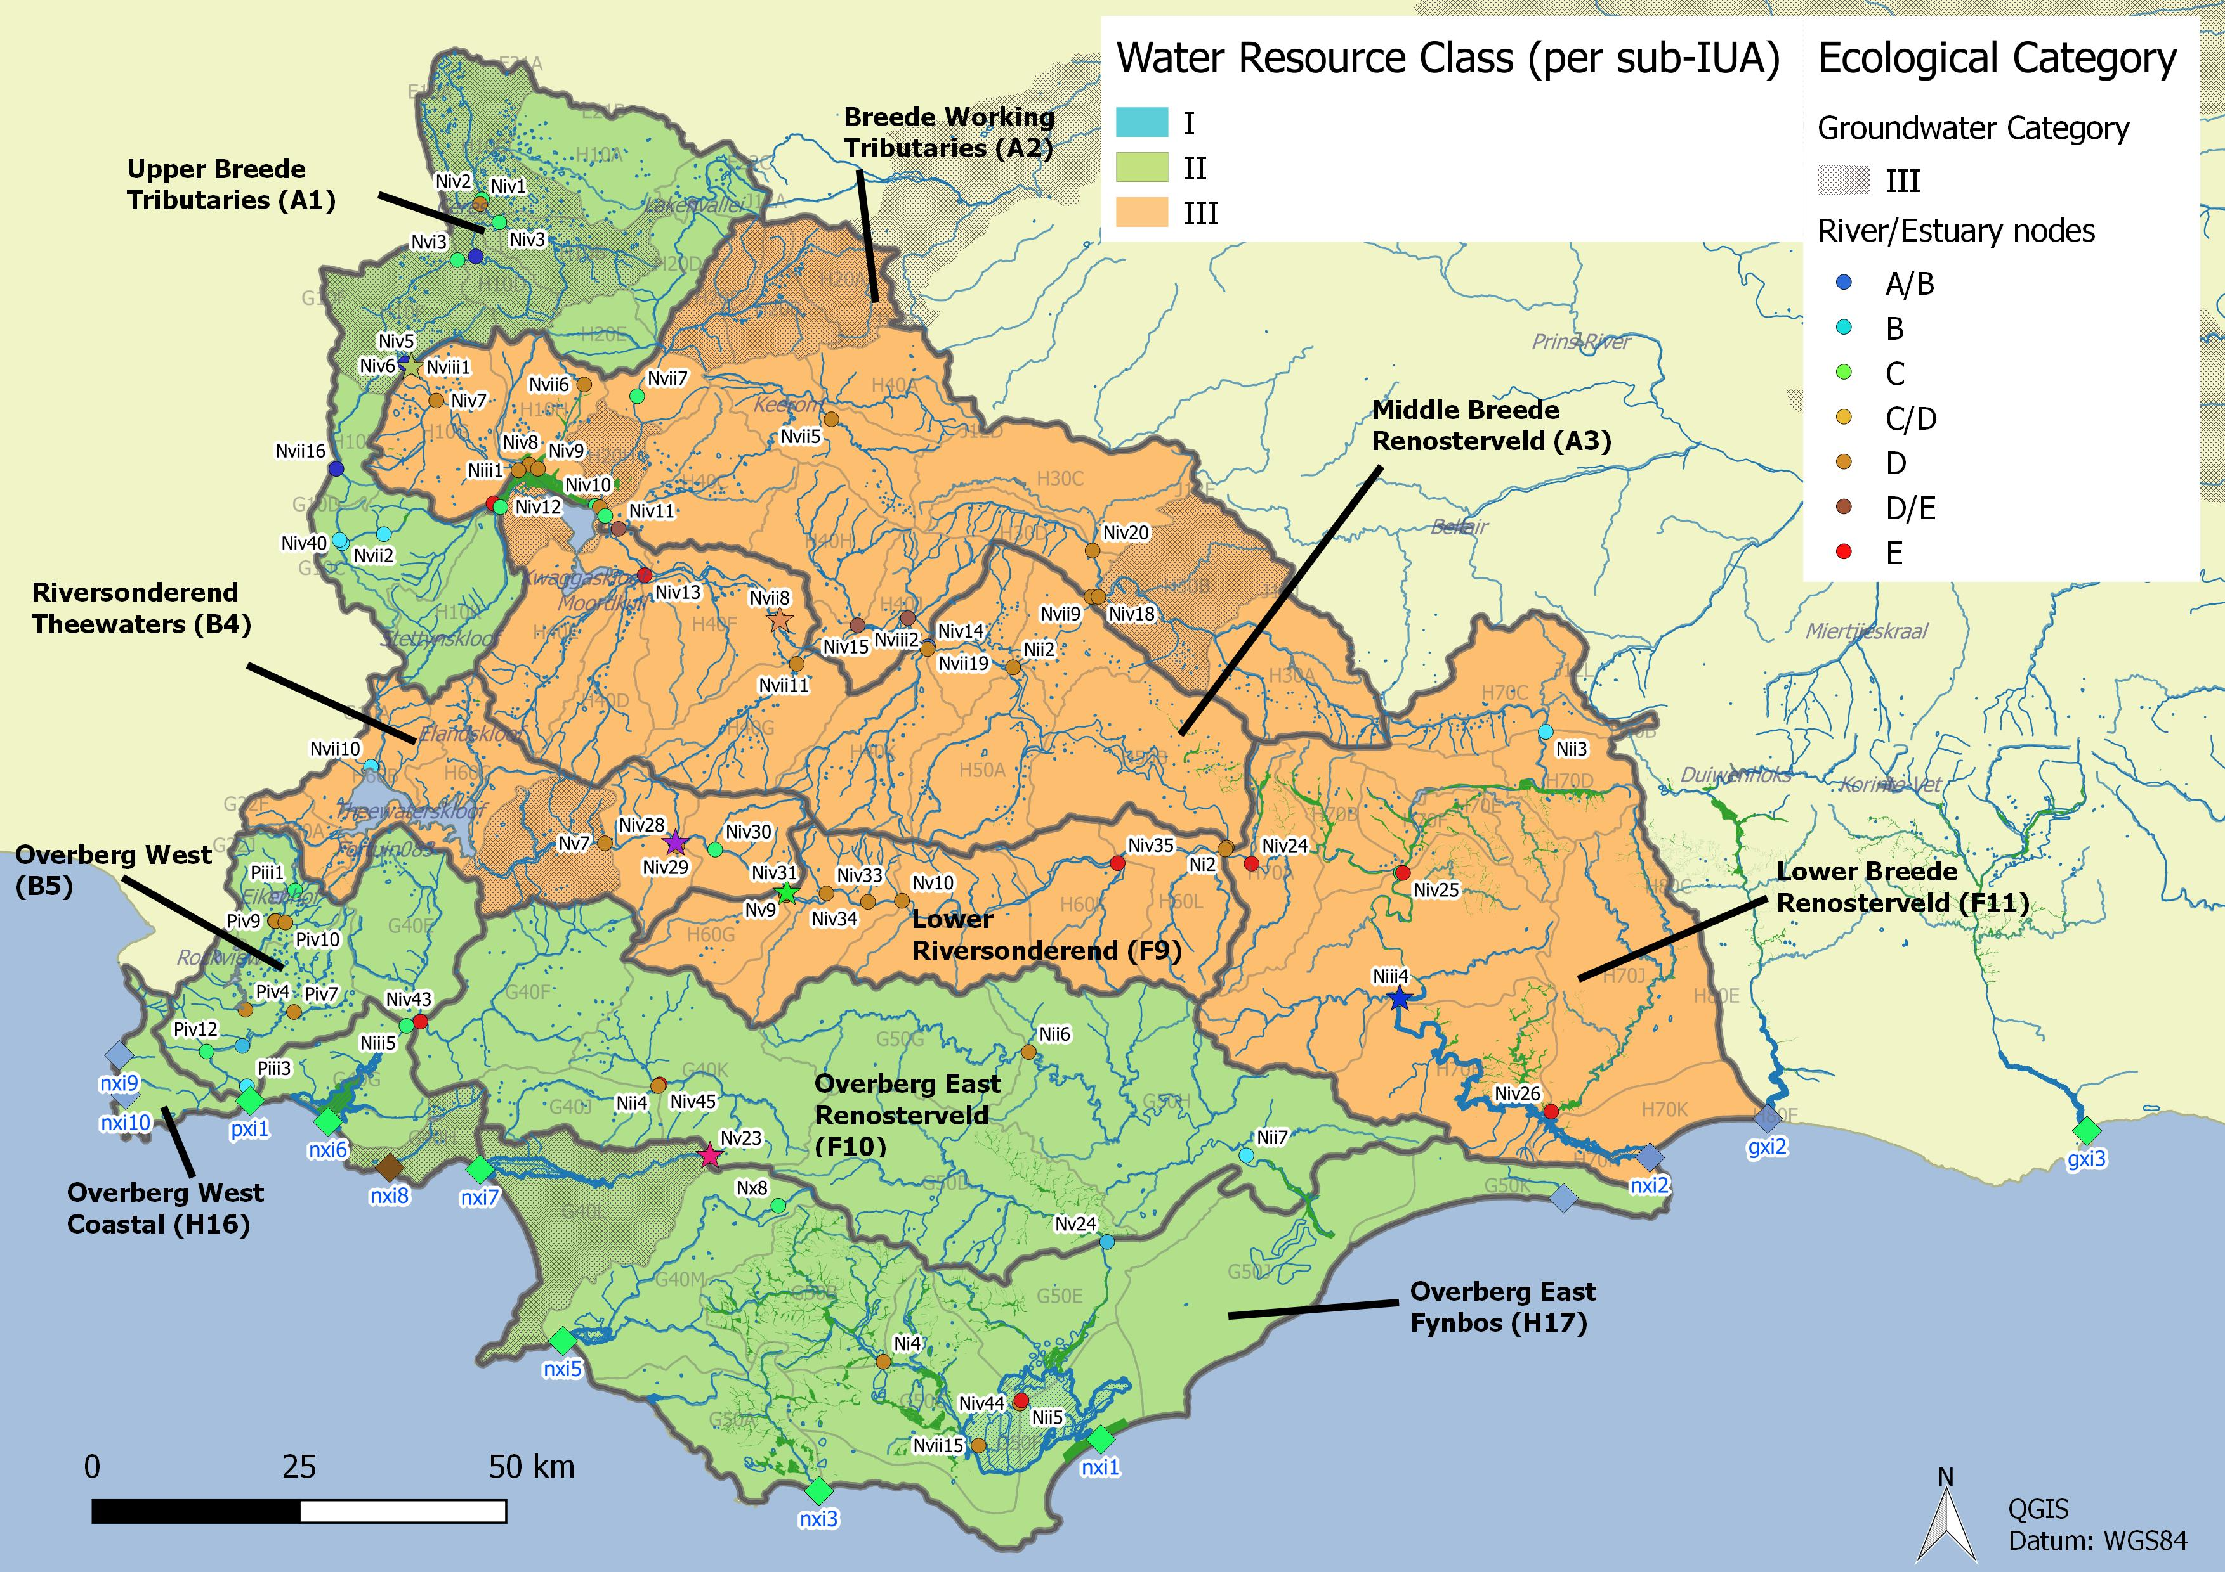
Integrated Units of Analysis and Nodes
Breede-Overberg Region

Slide 9
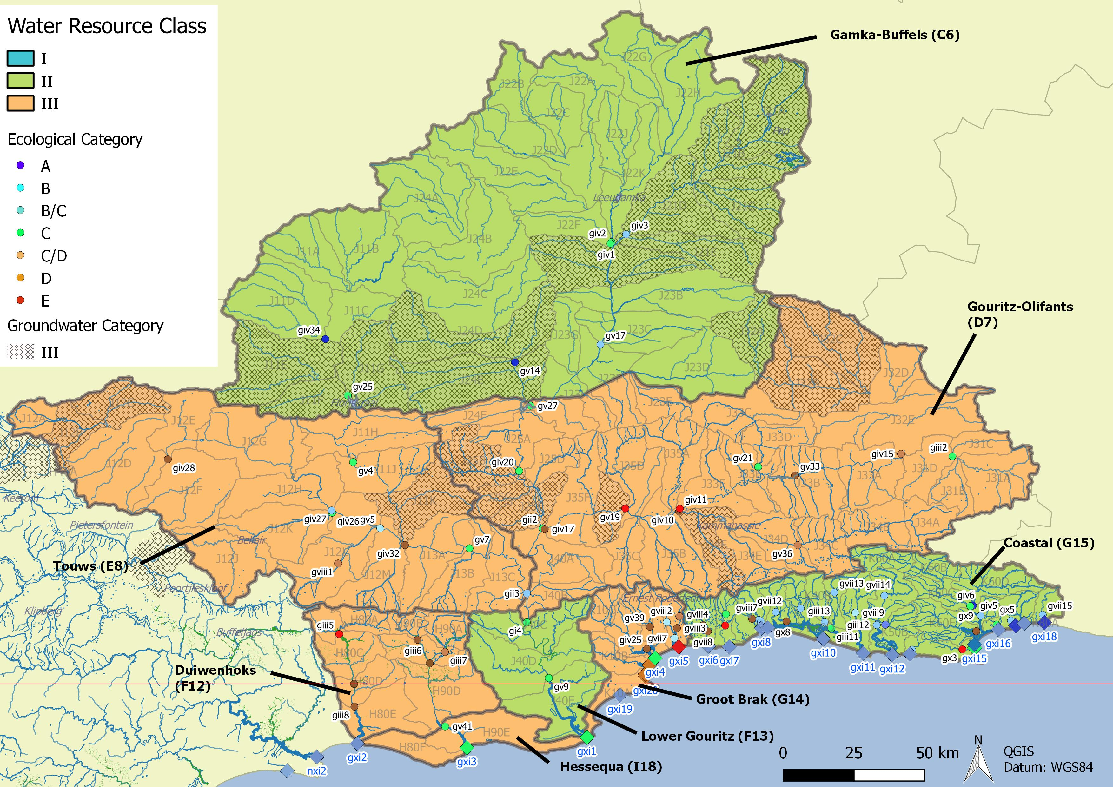
Integrated Units of Analysis and Nodes
Gouritz-Coastal Region

Slide 10
Gouritz-Coastal Region
 | Integrated Unit of Analysis (IUA) |  | Recommended Classes
 | Gamka Buffels | C6 | II
 | Touws | E8 | III
 | Gouritz-Olifants | D7 | III
 | Lower Gouritz | F13 | II
 | Duiwenhoks | F12 | III
 | Hessequa | I18 | III
 | Groot Brak | G14 | III
 | Coastal | G15 | II

Slide 11
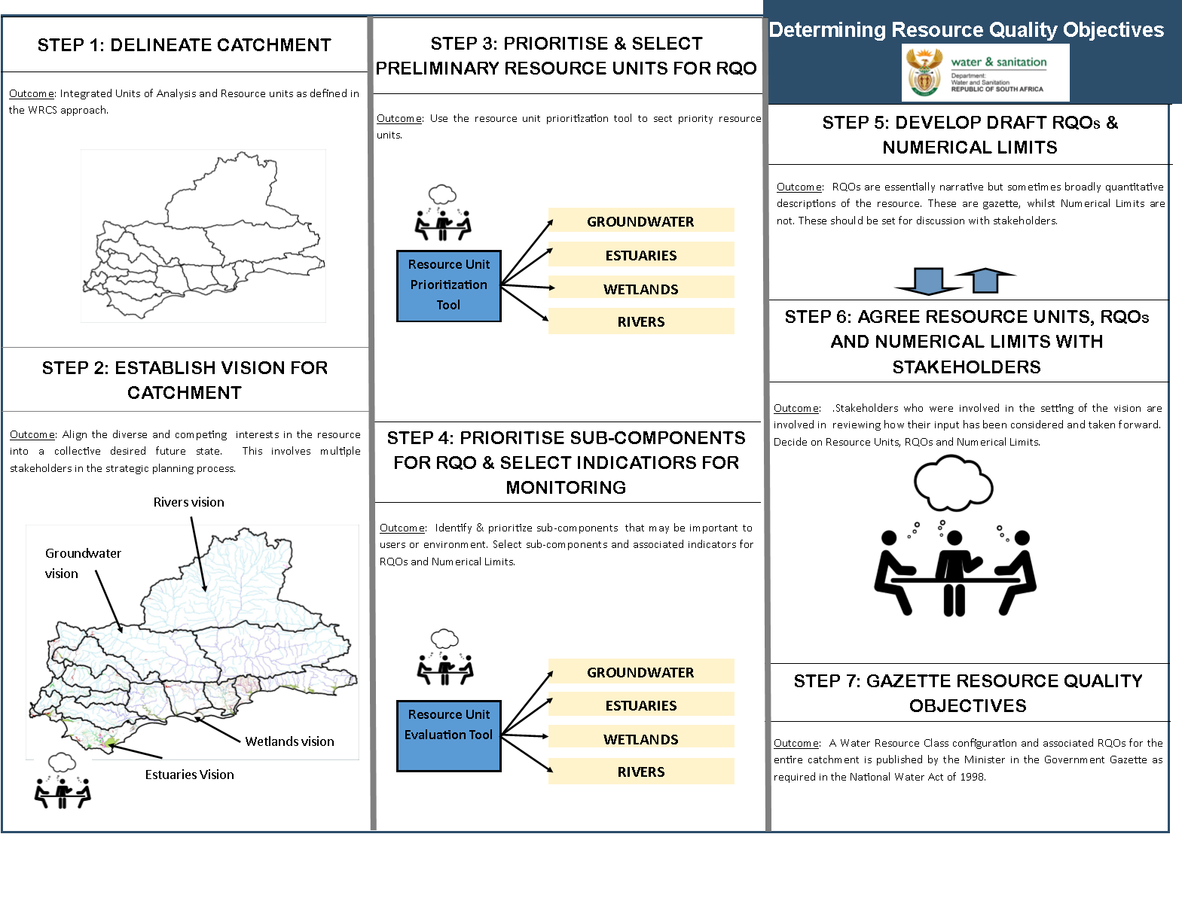
Study Status: RQOs
DAMS
Draft
Complete
Draft
Complete
DAMS
Draft
Notes:
Erik to present progress, Reminder of two stage process (Classification followed be RQOs – but gazetted together). Link to RQOs? Then zoom in on the classification process

Slide 12
Comments on draft RQO Reports
Three RQO Reports disseminated for comment:
  Resource Unit Prioritisation Report
  Evaluation of Resource Units Report
  Outline of RQOs Report
Please provide comment by 22 March to:
  Esther Lekalake (LekalakeE@dws.gov.za), or
  Louise Lodenkemper (Louise.Lodenkemper@aurecongroup.com)

Slide 13
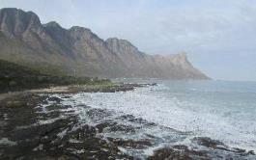
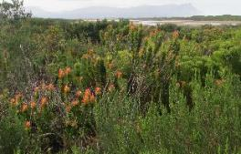
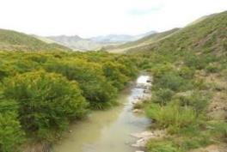
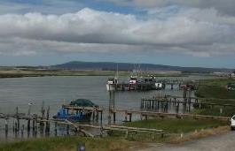
Thank you, Any discussion?

Slide 14
Determination of RQOs
Notes:
Erik and team to present the methodology used for scenario evaluation

Slide 15
Terminology
Ecological Reserve studies – set flow quality and quantity for water resource condition and basic human needs
  Ecological Water Requirement (EWR) sites
Classification – determines condition classes I – III
  Integrated Units of Analysis (IUA)
Resource Quality Objectives – descriptive (words) and numerical (number) statements to measure resource quality
Resource Units – rivers, lakes, wetlands, groundwater

Slide 16
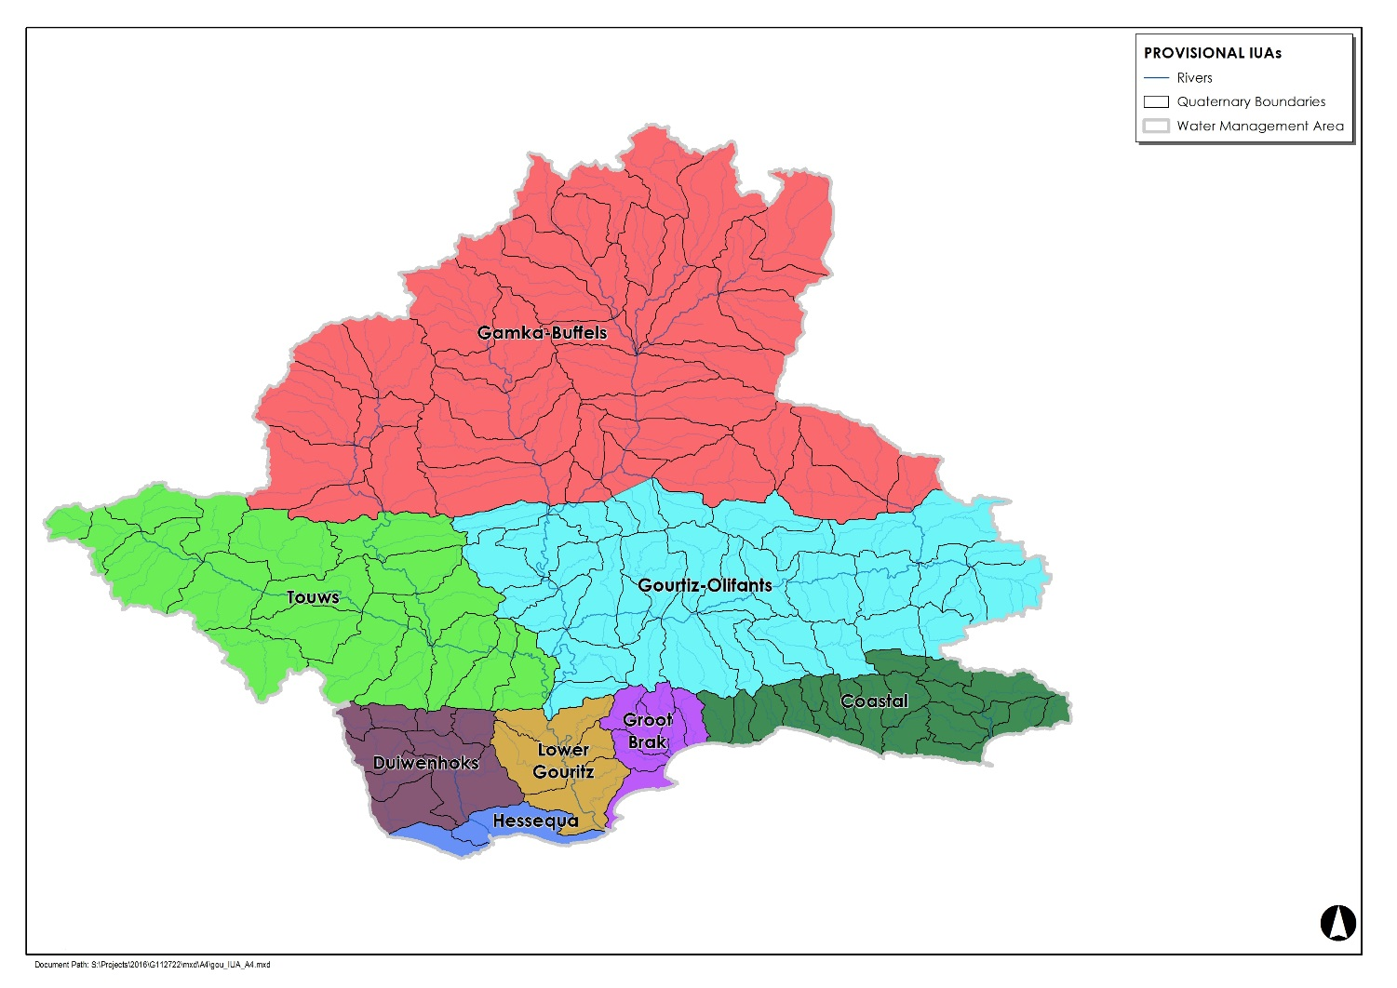
Steps to RQOs
IUAs - a combination of socio-economic and biotic boundaries
RUs for rivers were quaternary catchments
  RUs were prioritised
  RUs were evaluated
  RQOs were written
Notes:
Part of the purpose is to try focus attention at all the areas of the basin that differ from one another…to be representative as a whole across the basin

Slide 17
Resource Unit priorities - method
2 levels of ranking RUs at a quaternary level
  Quats with nodes were selected first as these were chosen based on a range of biophysical, water resource and socio-economic reasons
  The ‘DWS RU prioritisation tool’ was used to rank RUs against one another based on:
    position, socio-economic and international importance
    role in regulating services and ecological importance
    management actions needed or taking place
Notes:
Management only looks at nodes in poor condition and then EWR sites

Slide 18
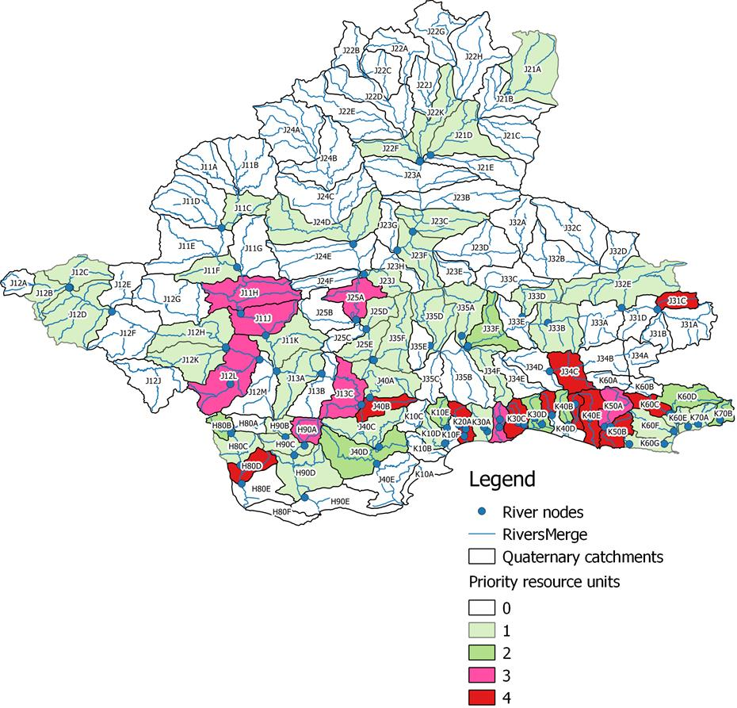
High and low priority RUs

Slide 19
High priority RUs

Slide 20
Evaluation of RUs - method
The ‘DWS RU evaluation tool’ was used to select indicators for which RQOs (descriptive and numerical) were written based on:
  Activities that impact on the water resource
    Dams, IBTs, afforestation, agriculture and so on
  User requirements
    Conservation and ecosystem characteristics (including PES, trajectory of change)
    Industry, agriculture, ecotourism, real estate (including fitness for use and trajectory of change)
Notes:
Evaluation of Rus method statement

Slide 21
Examples of indicators
Hydrology - low flows and high flows, monthly average volume (MCM)
Ecological condition – IHI, PAI, GAI, VEGRAI, MIRAI, FRAI
Geomorphology – sediment particle size (D₅₀)
Aquatic and riparian vegetation - % cover of indigenous and alien cover in 3 zones
Macroinvertebrates – SASS and ASPT scores, # of families present, key indicator families
Fish – CPUE of fish species present, FROC
Notes:
RQOs method statement

Slide 22
RQOs - method
TEC was the REC scenario
20 high priority RUs in the Gouritz (9) and Outeniqua (11)
  Descriptive RQOs, numerical limits and TPCs
40 Gouritz River nodes and 32 Outeniqua nodes
  Hydrological and ecological condition RQOs
Notes:
RQOs method statement

Slide 23
Gouritz and Outeniqua RQOs – low priority
Target Ecological Condition from the REC scenario
Monthly average volume (MCM) that include inter-annual floods (return period > 2 years)
Annual volume (MCM) – sum of months
%nMAR – annual flow as a % of natural

Slide 24
Gouritz River basin RQOs – high priority
2 different sets
Gouritz River Reserve study
  E.g. GOUR_DORI_J12L
Other
  E.g. GOUR_GROO_J11J
Notes:
DRAFT RQOs

Slide 25
Outeniqua RQOs – high priority
2 different sets
Groot Brak Reserve study
  E.g. OUTE_GROO_K10E
Knysna River study
  E.g. OUTE_DIEP_K40A
Notes:
DRAFT RQOs

Slide 26
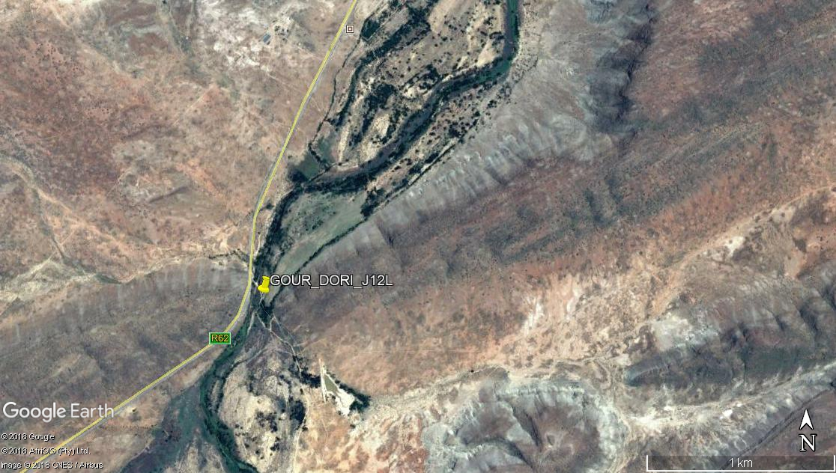
Doring River @ GOUR_DORI_J12L

Slide 27
Doring River @ GOUR_DORI_J12L
Flow
Excludes inter-annual floods

Slide 28
Doring River @ GOUR_DORI_J12L
Water quality

Slide 29
Doring River @ GOUR_DORI_J12L

Slide 30
Doring River @ GOUR_DORI_J12L

Slide 31
Doring River @ GOUR_DORI_J12L

Slide 32
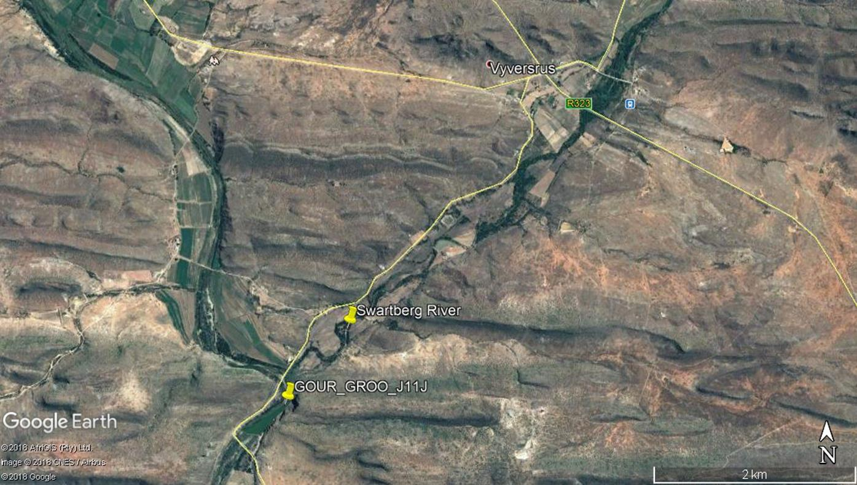
Groot River @ GOUR_GROO_J11J

Slide 33
Groot River @ GOUR_GROO_J11J
Flow
Excludes inter-annual floods

Slide 34
Groot River @ GOUR_GROO_J11J
Water quality

Slide 35
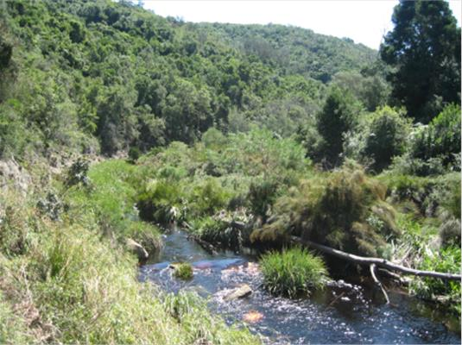
Groot Brak River @ OUTE_GROO_K10E

Slide 36
Groot Brak River @ OUTE_GROO_K10E
Flow
Excludes inter-annual floods

Slide 37
Groot Brak River @ OUTE_GROO_K10E
Water quality

Slide 38
Groot Brak River @ OUTE_GROO_K10E

Slide 39
Groot Brak River @ OUTE_GROO_K10E

Slide 40
Groot Brak River @ OUTE_GROO_K10E

Slide 41
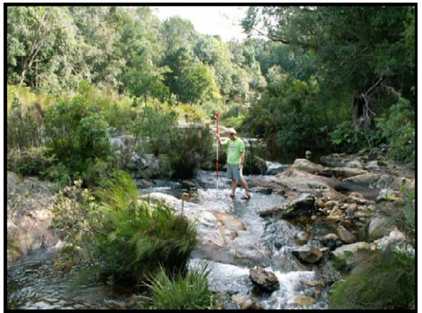
Diep River @ OUTE_DIEP_K40A

Slide 42
Diep River @ OUTE_DIEP_K40A
Flow
Excludes inter-annual floods

Slide 43
Diep River @ OUTE_DIEP_K40A
Water quality

Slide 44
Diep River @ OUTE_DIEP_K40A

Slide 45
Diep River @ OUTE_DIEP_K40A

Slide 46
Diep River @ OUTE_DIEP_K40A

Slide 47
SWA, FEPAs and protected areas
FEPAs, CBAs, ESAs
SWA, where current day > 70% of natural
Rivers important for fish conservation
Table of quaternary and/or coordinate taking note of these areas but not writing RQOs specifically – double edged sword?
Will not be gazetted but part of the RQO document

